Slide 1
Life Expectancy exploration
Comparing five countries
—France, Norway, Spain, Sweden, Denmark—
with the gapminder data frame

Slide 2
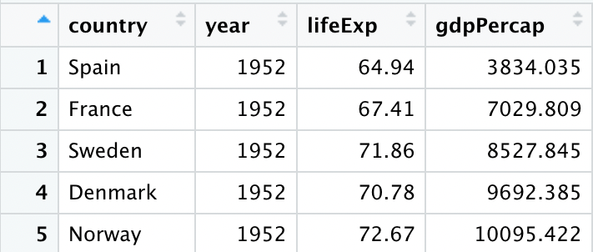
Out of the five countries chosen, which five has the lowest/highest per capita gdp in 1952?
The country with the lowest per capita GDP is Spain.
The country with the highest per capita GDP is Norway.
Gm_lowest1952 <- gm_five %>% filter(year==1952) %>% arrange(gdppercap)

Slide 3
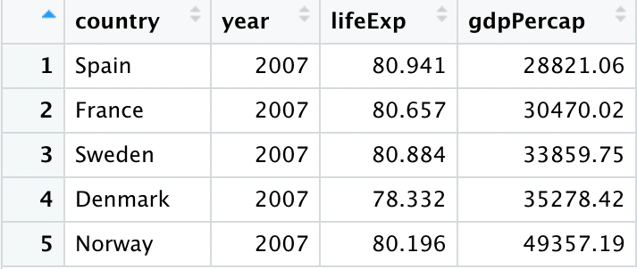
Out of the five countries chosen, which five has the lowest/highest per capita gdp in 2007?
The country with the lowest per capita GDP is Spain.
The country with the highest per capita GDP is Norway.
Gm_lowest2007<- gm_five %>% filter(year==2007) %>% arrange(gdppercap)

Slide 4
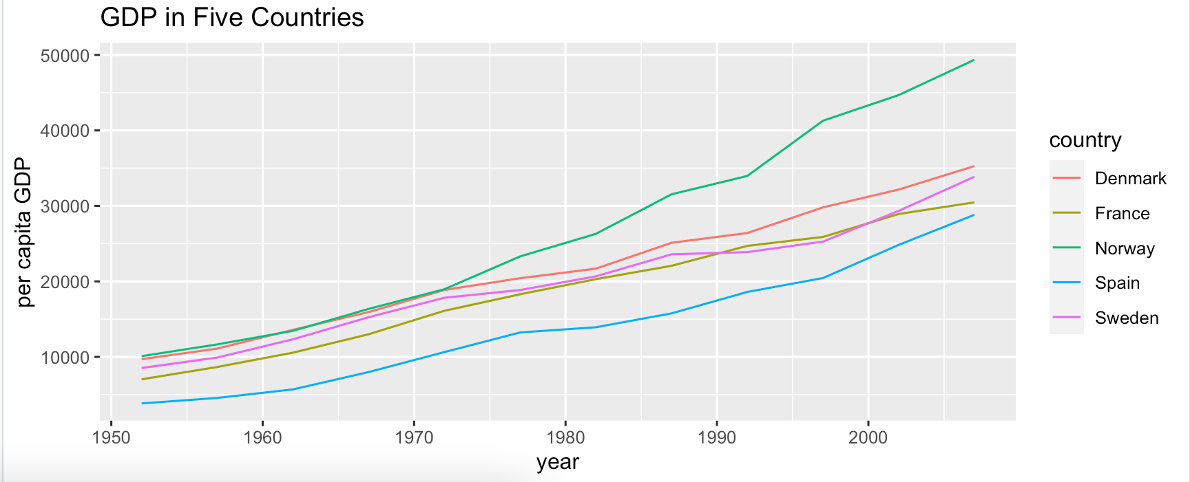
Line graph of gdp in the five countries
ggplot(gm_five) + geom_line(aes(x = year, y = gdpPercap, color = country)) +
ylab("per capita GDP") + ggtitle("GDP in Five Countries")

Slide 5
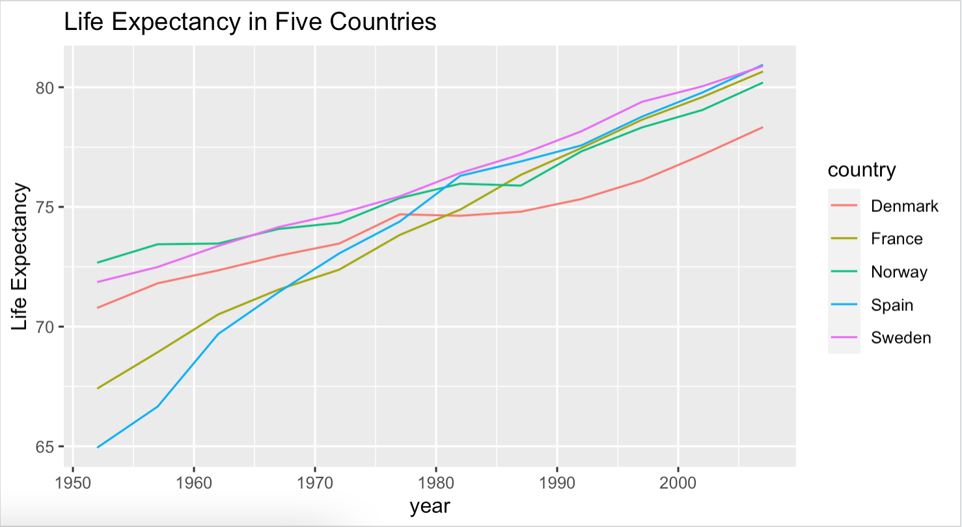
Life expectancy in five countries
Starting in 1952, Spain shows the lowest life expectancy out of the five countries that were chosen, probably as a consequence of the civil war that some believe didn't, in fact, end in 1939 but in 1952. Norway shows the highest life expectancy in 1952 out of the five countries chosen. Ending in 2007, Spain's life expectancy has dramatically increased and has nearly taken over as the highest along with Sweden. Denmark's life expectancy has not had as much of a dramatic increase from 1952-2007, thus is the lowest out of the five countries in 2007.
ggplot(gm_five) + geom_line(aes(x = year, y = lifeExp, color = country)) +
ylab("Life Expectancy") + ggtitle("Life Expectancy in Five Countries")

Slide 6
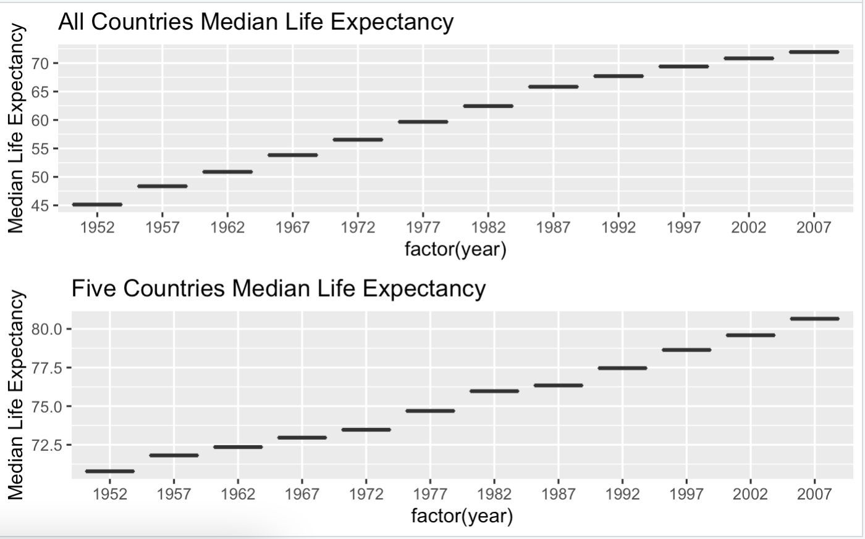
Comparing: entire gapminder data frame vs. five countries chosen
Without even looking at each of the years from 1952-2007 and just looking at the ages that the y-axis is organized with, one can see that the overall median ages for the five countries selected have a dramatic higher average than the overall medians of the countries when calculated all together.
life.boxplot <- ggplot(life, aes(x = factor(year), y = life.med)) + geom_boxplot() + ylab("Median Life Expectancy") +
ggtitle("All Countries Median Life Expectancy")
gm_fivemedians.boxplot <- ggplot(gm_fivemedians, aes(x = factor(year), y = life_med)) + geom_boxplot() +
ylab("Median Life Expectancy") + ggtitle("Five Countries Median Life Expectancy")
grid.arrange(life.boxplot, gm_fivemedians.boxplot, ncol = 1)

